Slide 1
AUTOSAR Ethernet Stack

Slide 2
Agenda:
Ethernet Basics
OSI Model
Autosar Ethernet Architecture
Ethernet Protocol Frame Format
Communication stack

Slide 3
1. What is Automotive Ethernet
Automotive Ethernet is a physical network that is used to connect components within a car using a wired network. It is designed to meet the needs of the automotive market, including meeting electrical requirements , bandwidth requirements, latency requirements, synchronization, and network management requirements.
The single twisted pair is a fundamental difference between standard Ethernet and automotive Ethernet. Unlike standard ethernet, with a dedicated transmit-and-receive path, automotive Ethernet, has a single twisted pair being used for both transmit and receive operations at the same time
2. Why Ethernet using over CAN
As the demand for bandwidth, data rate, data security continues to go up for in vehicle communication automotive Ethernet overcomes limitation of traditional automotive serial buses and offers advanced capabilities to meet these needs
Ethernet can transport data over a link 100 times faster than a CAN bus. Ethernet is good for mid bandwidth communications in applications such as navigation systems and control. It can be used in much the same way as a CAN bus while providing much more bandwidth.

Slide 4
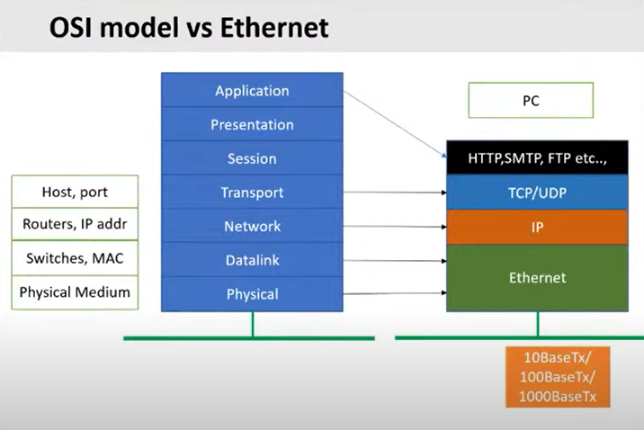

Slide 5
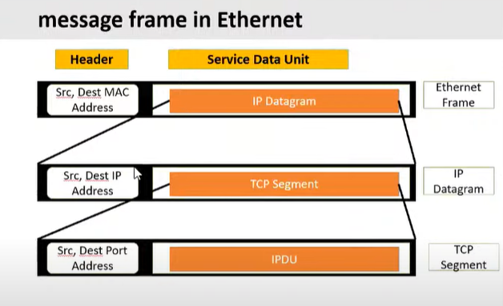
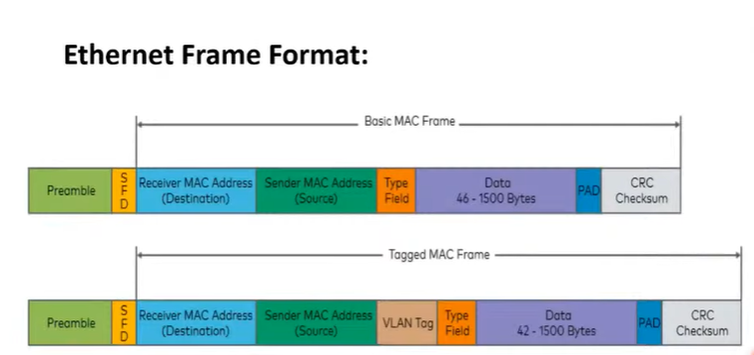
Ethernet Frame Format

Slide 6
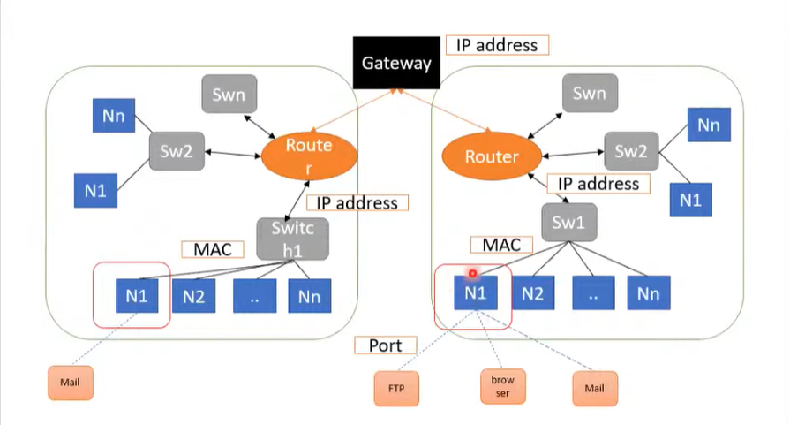
Network Communication

Slide 7
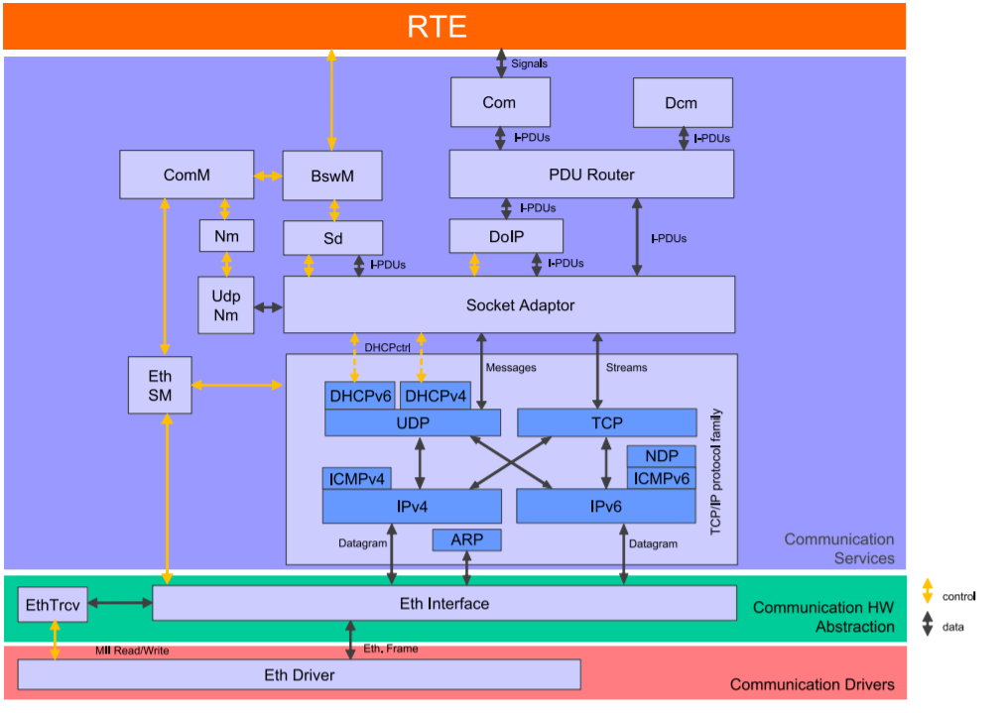
Autosar Ethernet Architecture

Slide 8
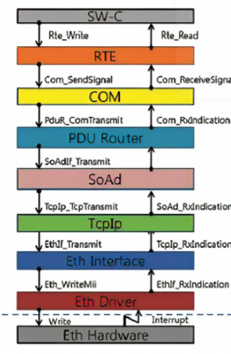
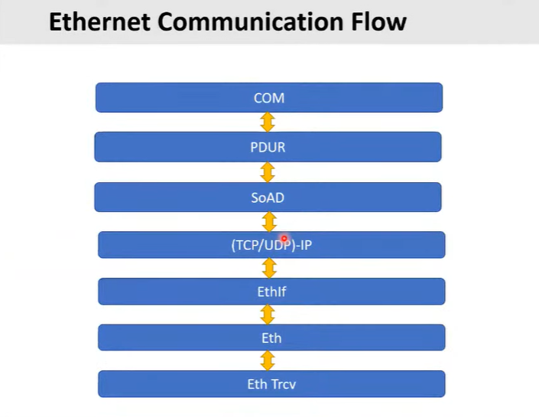
Autosar Ethernet Communiccation Flow
8
8

Slide 9
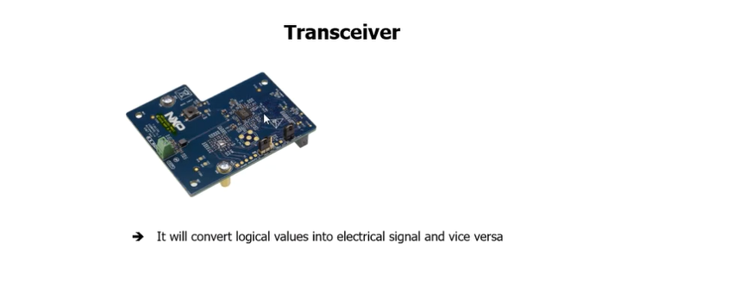
Ethernet Transceiver
1. In the AUTOSAR, the Ethernet Transceiver Driver belongs to the Micro controller Abstraction Layer.
2. Main Tasks of Ethernet Transceiver Driver to Provide hardware independent interface to the upper layer for the same type of multiple transceivers

Slide 10
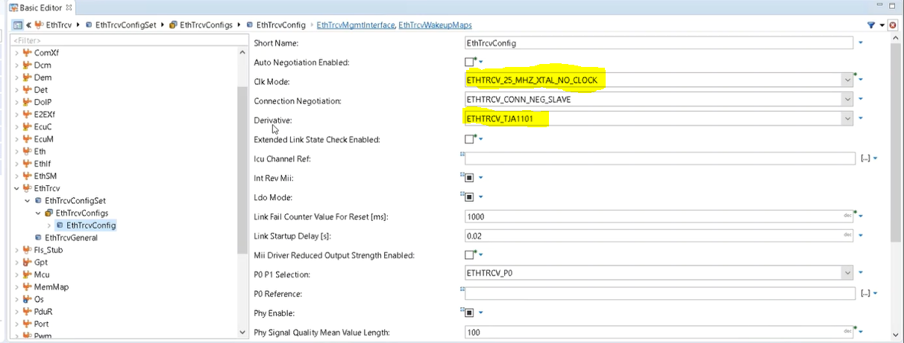
Ethernet Transceiver Configuration

Slide 11
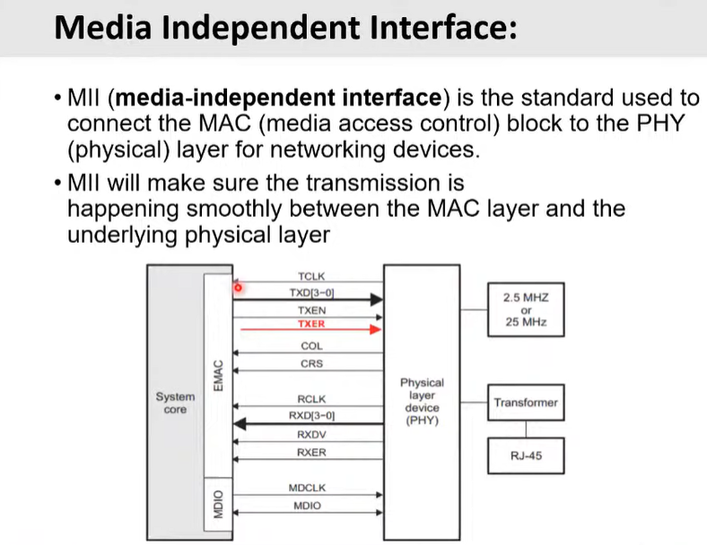
MII

Slide 12
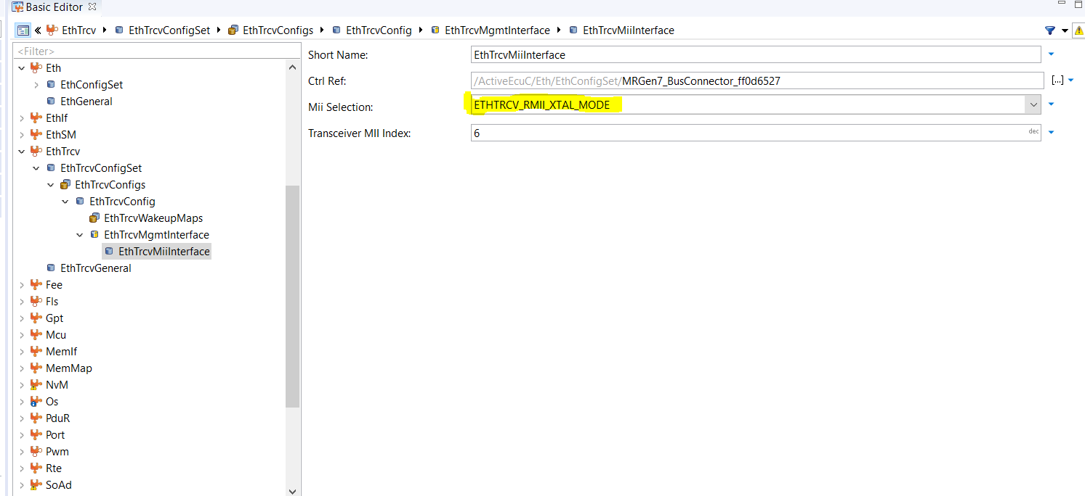
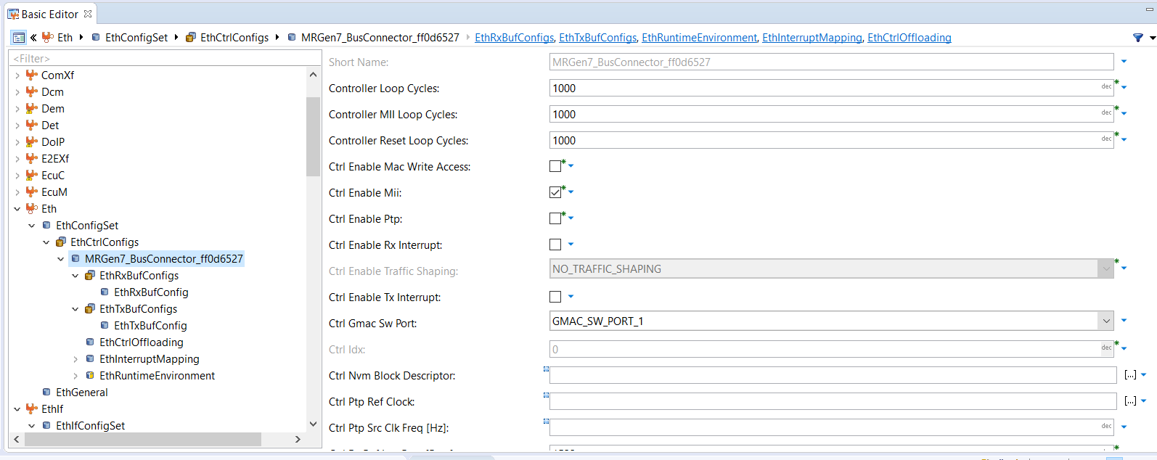
MII Selection Configuration

Slide 13
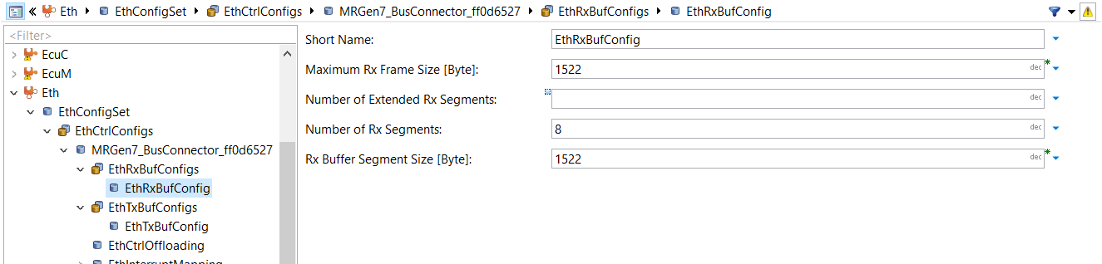
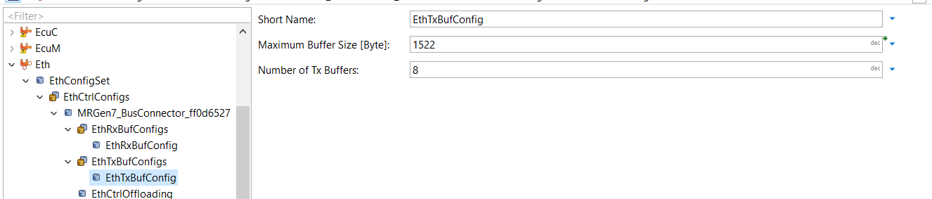
Ethernet Driver
In the AUTOSAR, the Ethernet Driver belongs to the Micro controller Abstraction Layer, or more precisely, to the Communication Drivers.
Main Tasks of Ethernet Driver to Provide hardware independent interface to the upper layer for the same type of multiple controllers.

Slide 14
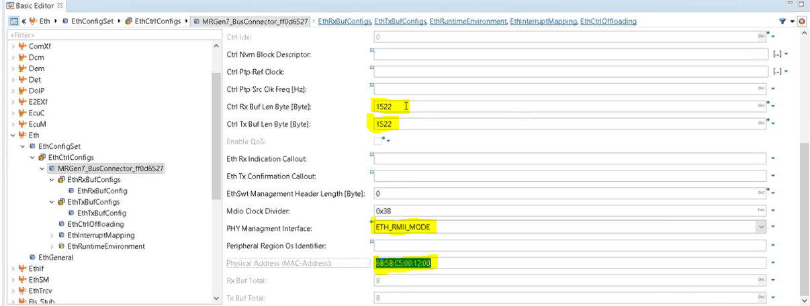
Buffer Configuration

Slide 15
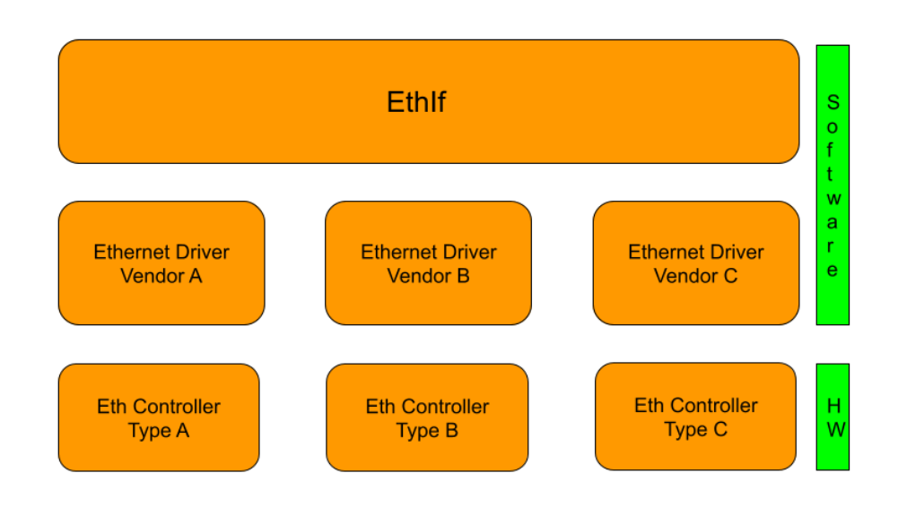
Ethernet Interface
In the AUTOSAR Layered Software Architecture, the Ethernet Interface belongs to the ECU Abstraction Layer, or more precisely, to the Communication Hardware Abstraction in Communication stack.
EthIf module Provide to upper layers a hardware independent interface to the Ethernet Communication System.

Slide 16
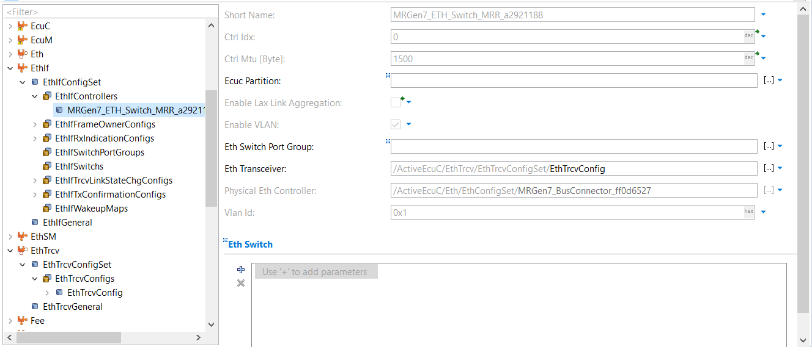
VLAN ID Configuration

Slide 17
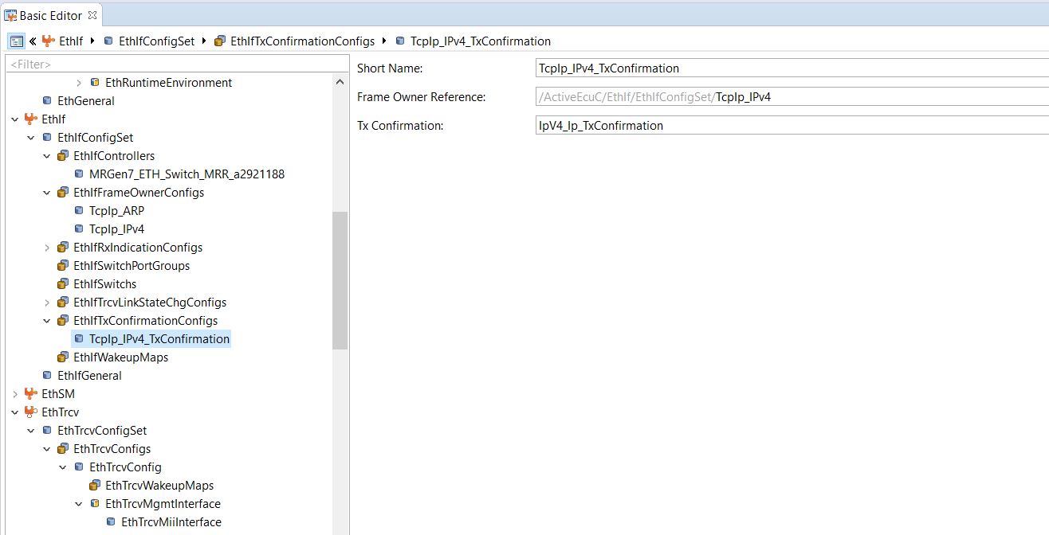
EthIf Tx Confirmation
17

Slide 18
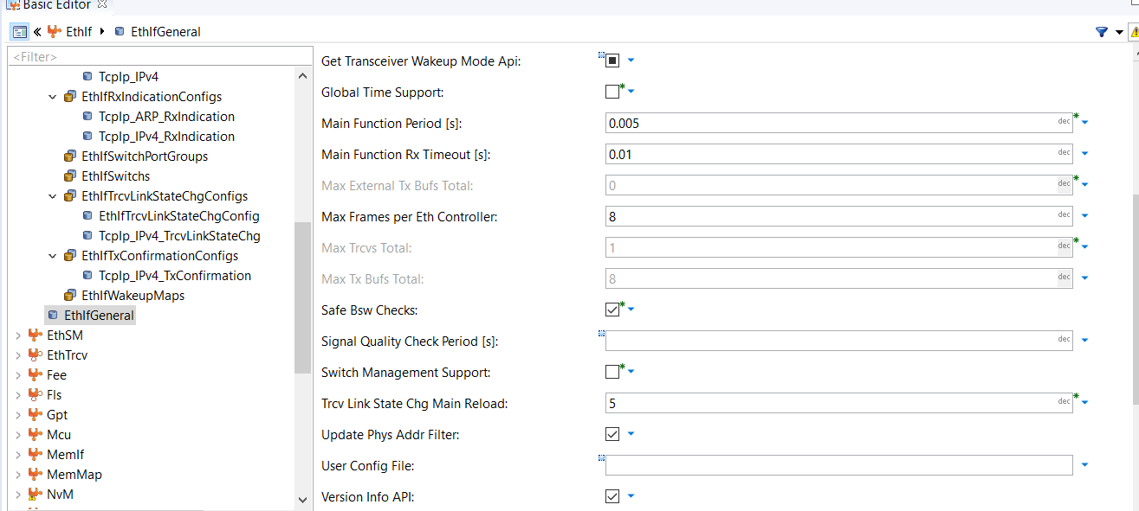
Config Maximum Number Of Trcv

Slide 19
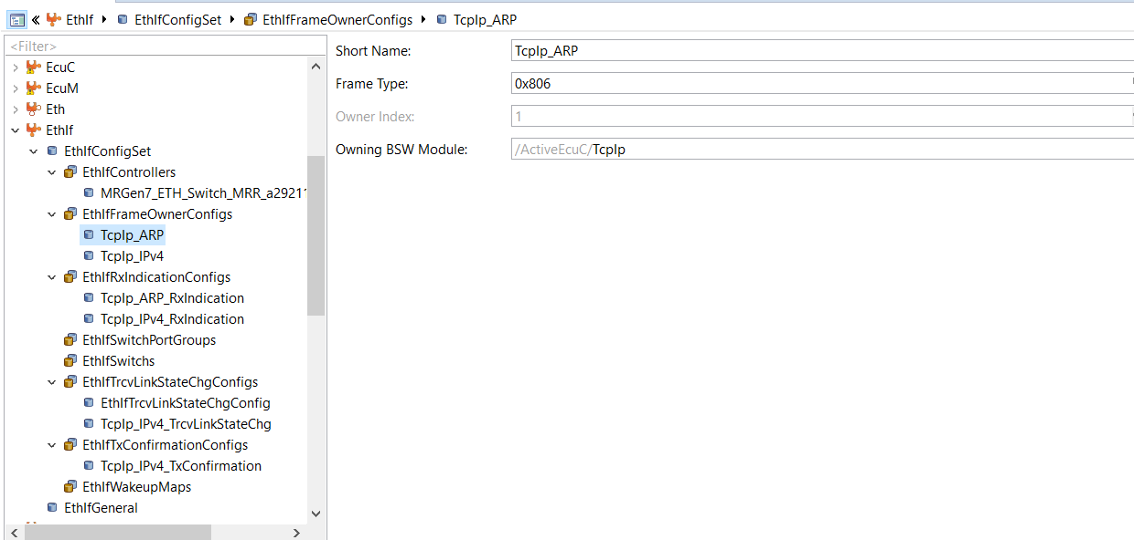
Tcp IP ARP Configuration

Slide 20
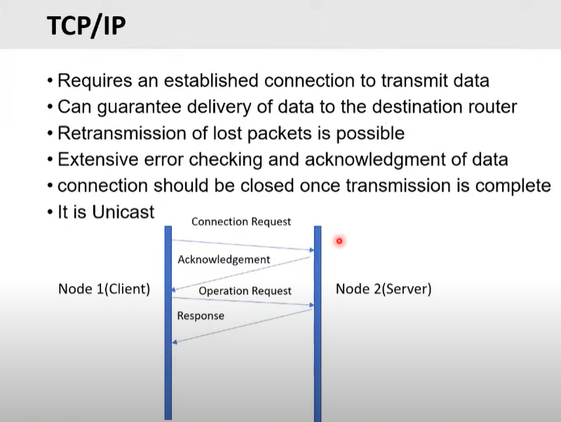
Transport Control Protocol
The TCP/IP Stack (TCP IP) is located between the Socket Adapter (SoAd) and the Ethernet Interface (EthIf) modules. And Autosar TCP/IP module functionality and normal TCP/IP module functionality are the same

Slide 21
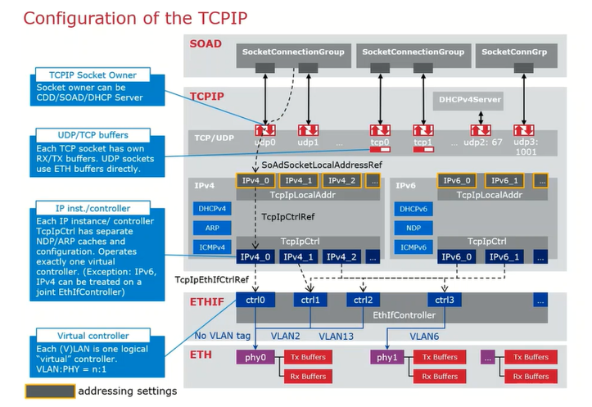

Slide 22
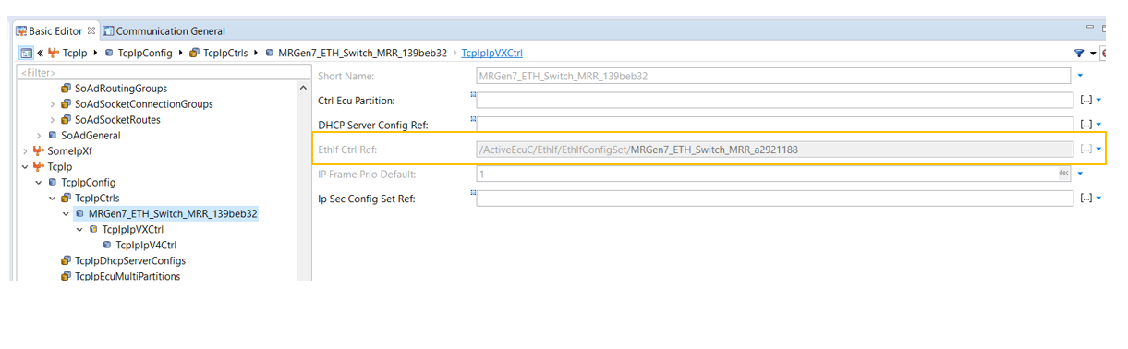
TCP/IP – EthIf Controller Reference

Slide 23
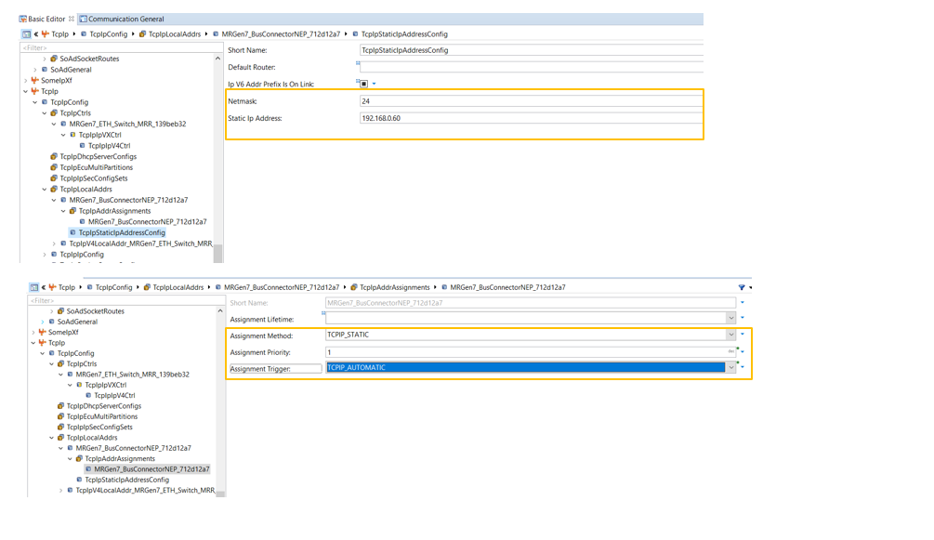
TcpIp - Local IP Configuration

Slide 24
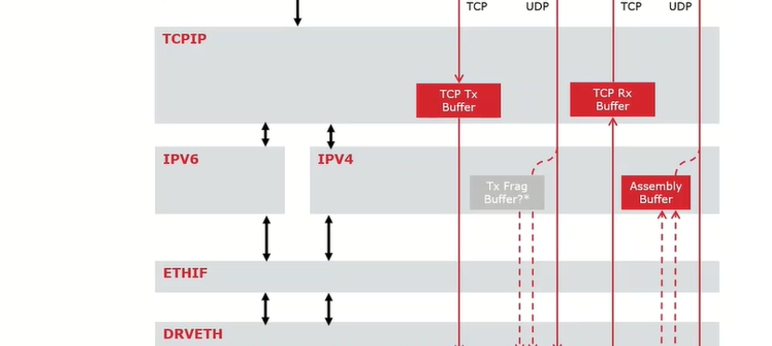
TCP-IP Buffering Concept

Slide 25
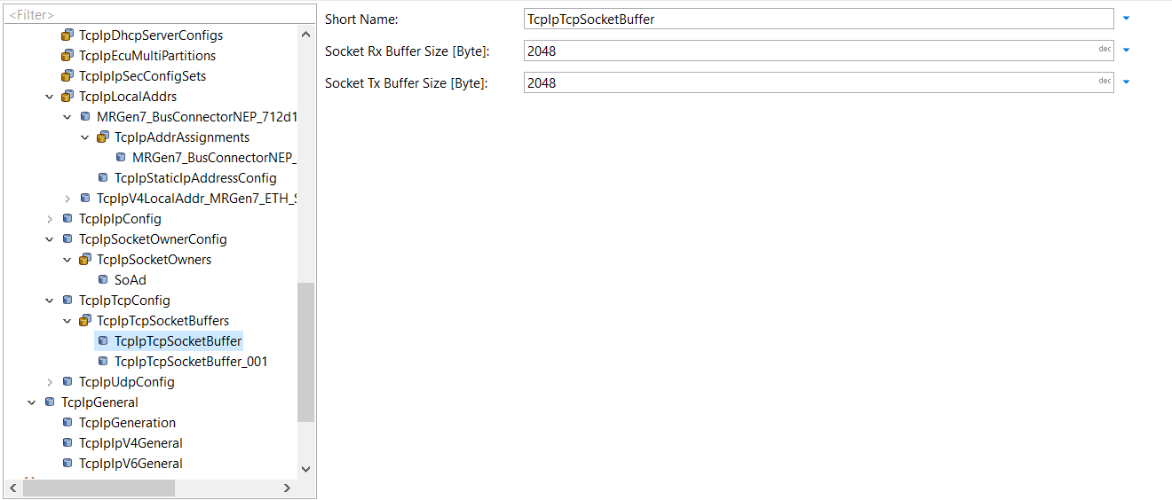
TcpIp- TCP and its buffer config

Slide 26
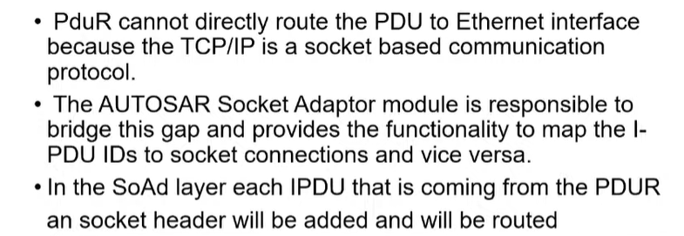
Socket Adaptor
26

Slide 27
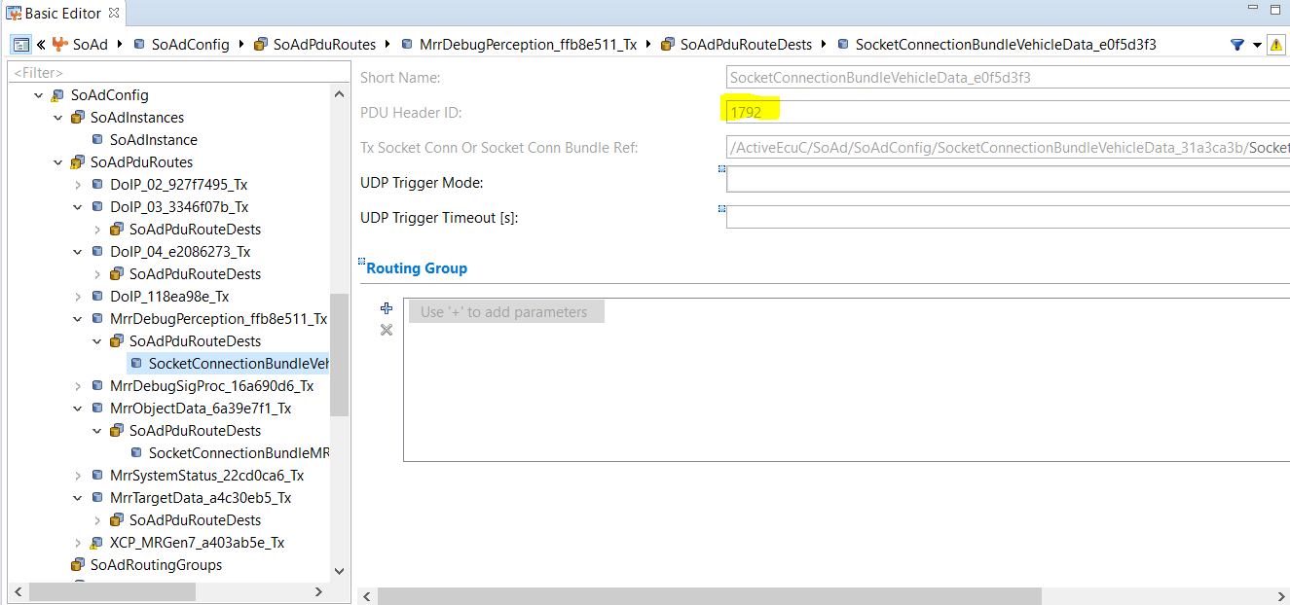
Header ID Configuration

Slide 28
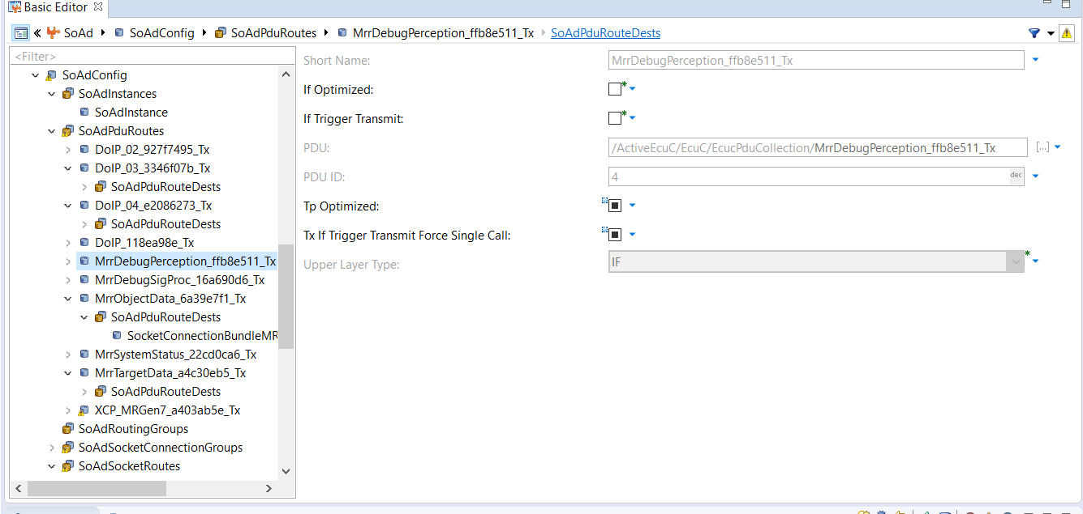
SOAD Configuration

Slide 29
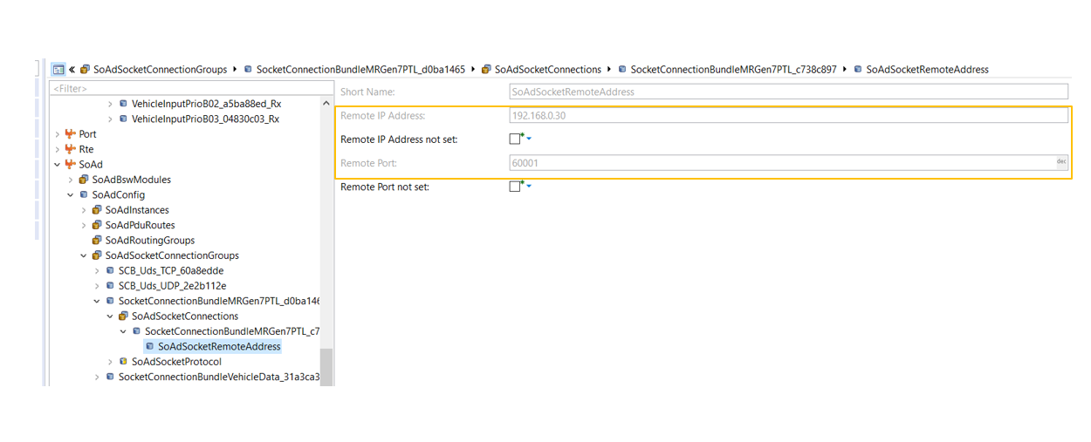
SoAD -Socket Connection :Remote IP and Port configuration

Slide 30
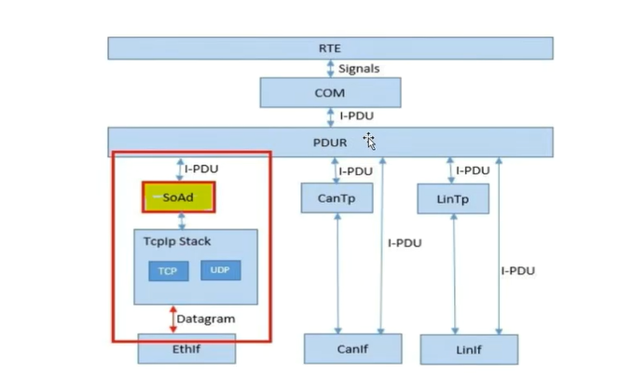
PDUR
PDU Router is a module responsible for routing the PDU to the respective Bus Specific Interface modules . Above the PDU Router module, all the PDUs are protocol independent. Below the PDUR, all the PDUs are routed to the protocol specific modules . PDUR is also the PDU level gateway for transmitting the received PDU from one Bus Specific Interface module to another Bus Specific Interface module.
The PDU Router also accomplishes the gateway functionality when the PDU is routed from one controller to another over the same protocol.

Slide 31
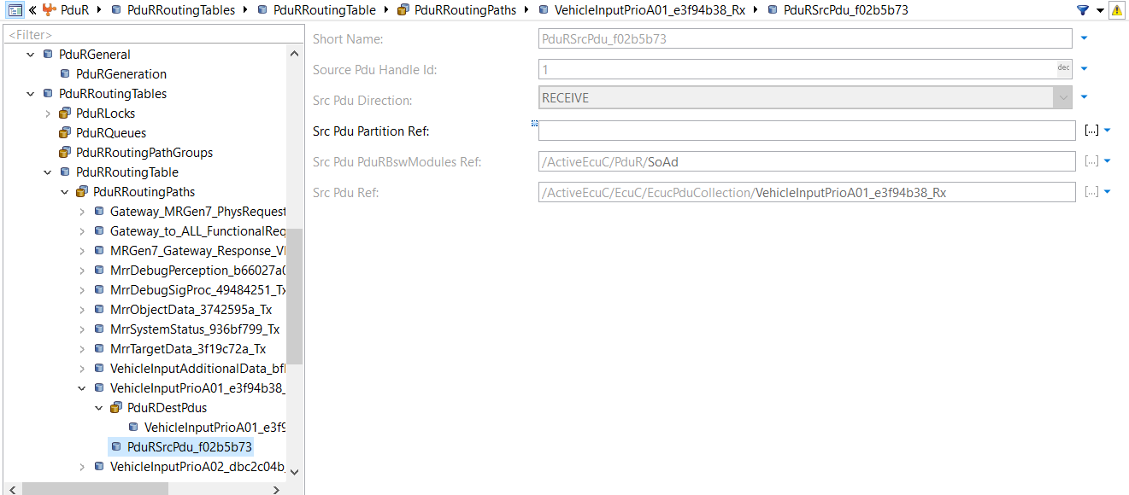
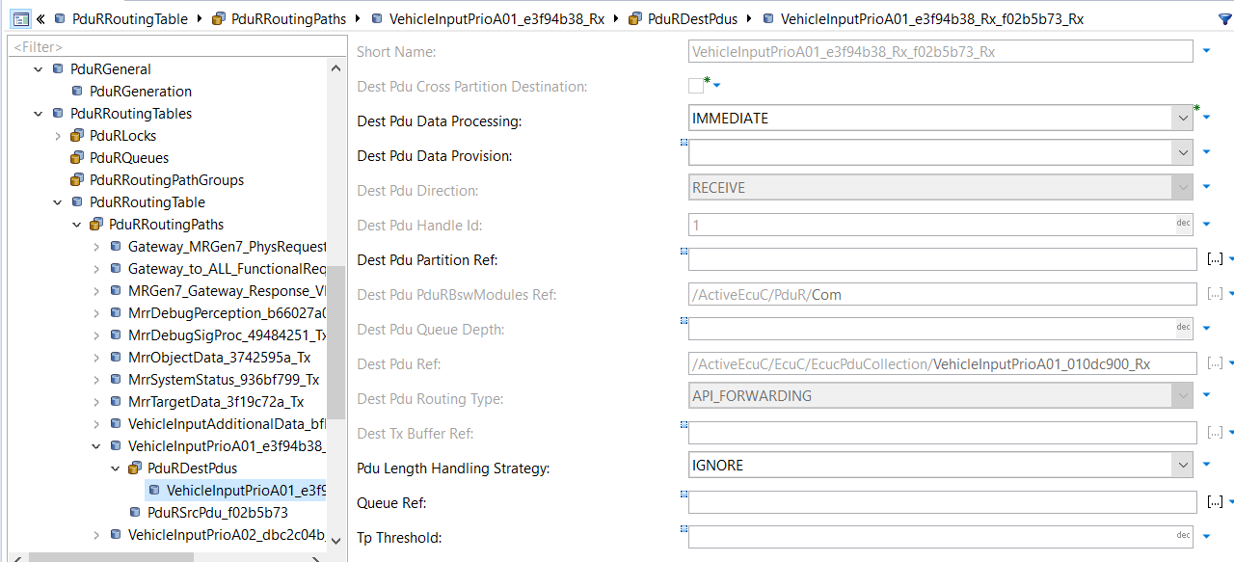
PDUR Configuration

Slide 32
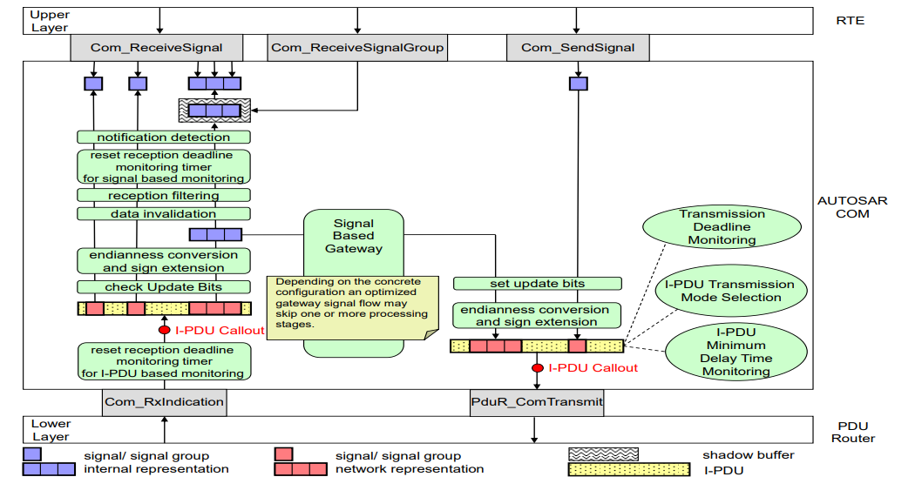
AUTOSAR COM
AUTOSAR COM is a module between the RTE and the PDU Router. It is based on OSEK COM specification and provides a uniform interface to the CAN Network. It is responsible for providing Signal level access to the application layer and PDU level access to the lower layers, independent of the protocol.It packs the signals to a PDU at the transmitter and unpacks the received PDU to provide signal level access to the application at the receiver. At the PDU level, COM is responsible for grouping of the PDUs, and starting/stopping of the PDU groups

Slide 33
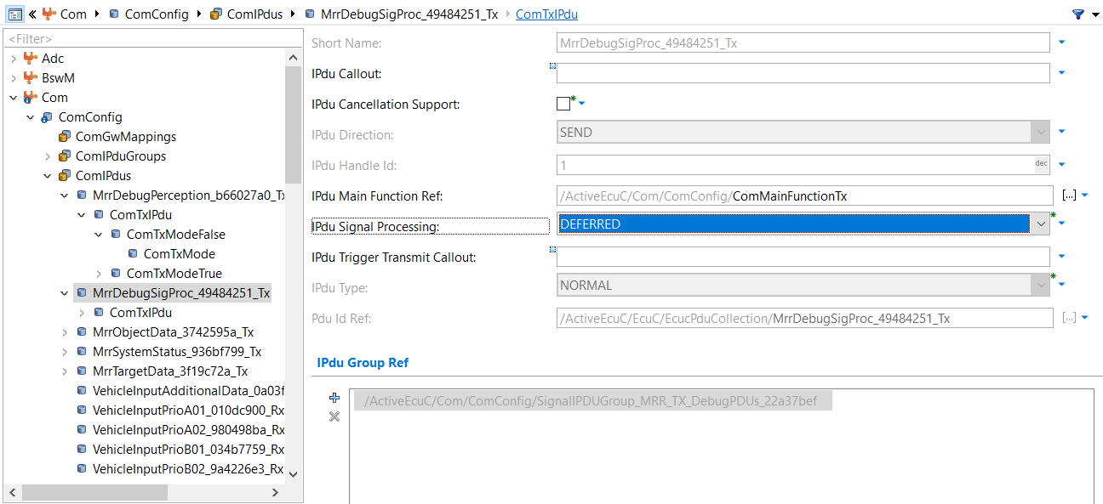
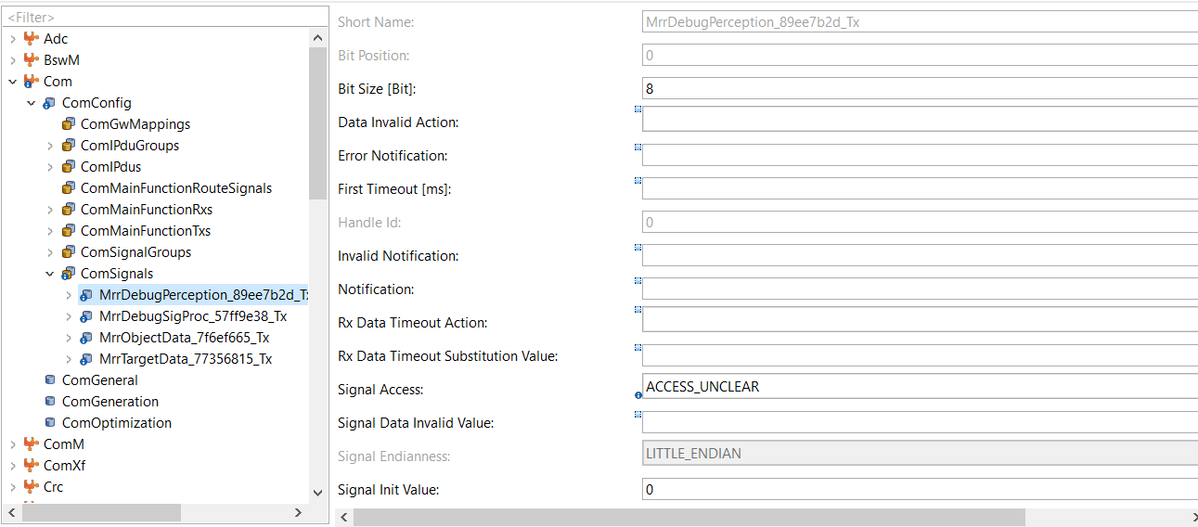
COM Configuration

Slide 34
Thank You !!

